Slide 1
Detailed classification of animal trajectories inside the Morris Water Maze
An updated analysis framework and the RODA software

Slide 2
Contents
Introduction to the Morris Water Maze.
Previous work on analysis methods in the Morris Water Maze.
Our analysis methodology
Software Demo.

Slide 3
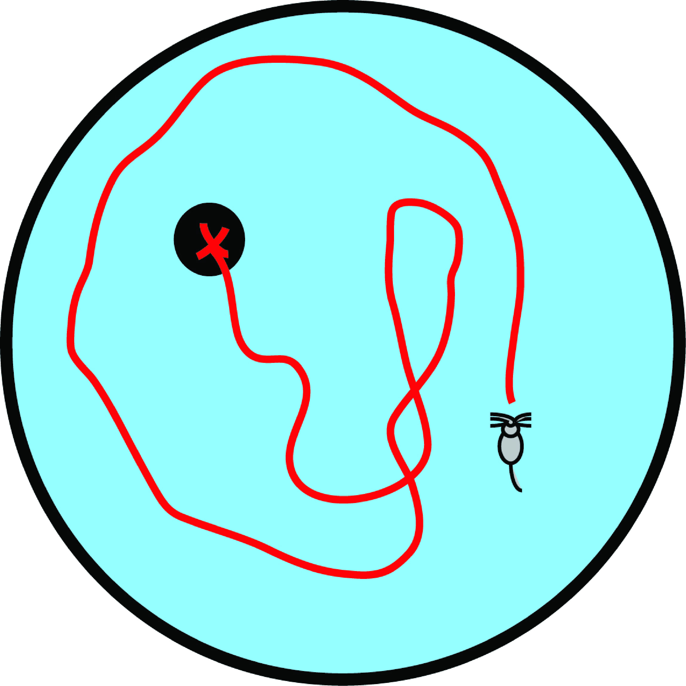
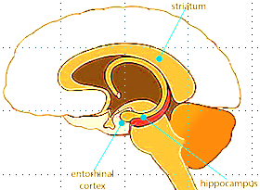
The Morris Water Maze (MWM)
Designed by Richard Morris (1981).
One of the most widely used tasks in behavioural neuroscience.
Study the psychological processes and neural mechanisms of spatial learning and memory.
A
ageing
diseases
nutrition
drugs
B

Slide 4
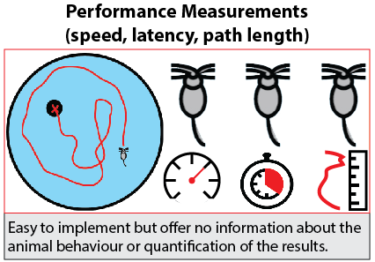
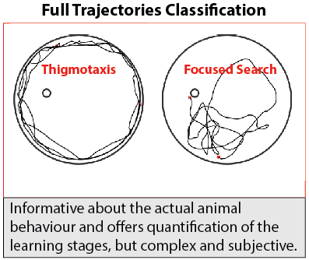
Data Analysis in the MWM
Notes:
Wolfer et al (1998): Classification is useful since classes of behaviour can be mapped to different stages of learning.

Slide 5
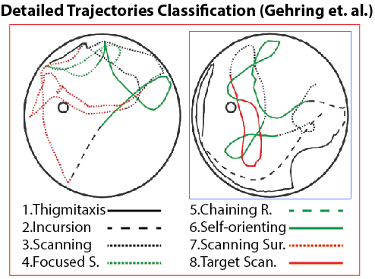
Our Analysis Methodology
[1] Gehring, T. V., Luksys, G., Sandi, C., & Vasilaki, E. (2015). Detailed classification of swimming paths in the Morris Water Maze: multiple strategies within one trial. Scientific reports, 5.
[2] Vouros et al. Manuscript under preparation.
Notes:
Animals implement a variety of strategies (behaviours) over each trial in order to solve the maze. Thus forcing the whole trajectory into 1 behavioural class in somewhat subjective [1].

Slide 6
Analysis Procedure
Segmentation
Notes:
Overlap is essential because we do not know where to split the trajectory. It offers a degree of certainty that information of importance won’t be lost due to unfavorable segmentation.

Slide 7
Analysis Procedure
Segmentation
Features

Slide 8
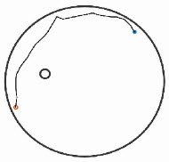
Analysis Procedure
Segmentation
Features
Labels
Thigmotaxis

Slide 9
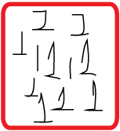
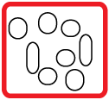
Analysis Procedure
Segmentation
Features
Classification
Labels
Classes
Features
Clusters
Labels

Slide 10
Analysis Procedure
Segmentation
Features
Classification
Labels
K
How many
Clusters?

Slide 11
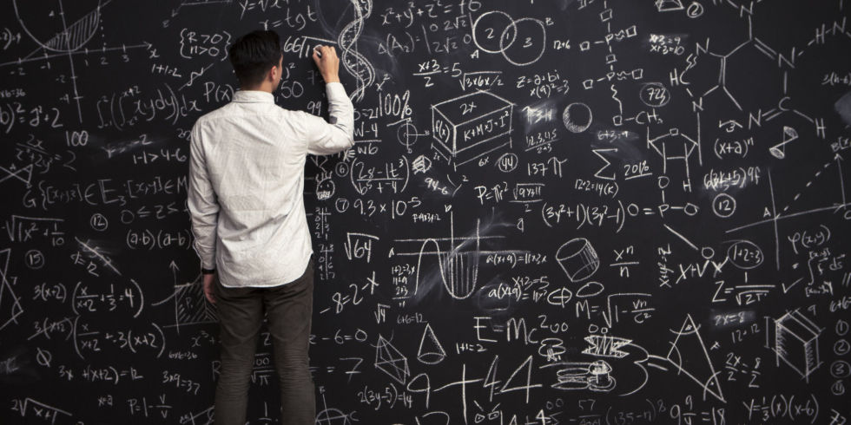
Analysis Procedure
Segmentation
Features
Classification
Labels
K

Slide 12
Analysis Procedure
Segmentation
Features
Classification
Labels
K
Classification
Results

Slide 13
Analysis Procedure
Segmentation
Features
Classification
Labels
K
Classification
Results

Slide 14
Ideas
How about an automatic classification tuning (aka K)?
Classification problem is complex how do I know that any automatic choice of tuning will be robust?
Well if I cannot define an optimal tuning why not try a number of them and merge them into 1 classification solution?

Slide 15
Classification Boosting with z Majority Voting
Thigmotaxis
Classifier 1
Thigmotaxis
Classifier 2
Incursion
Classifier 3
Thigmotaxis
Classifier N
Equality? Mark it as unclassified!

Slide 16
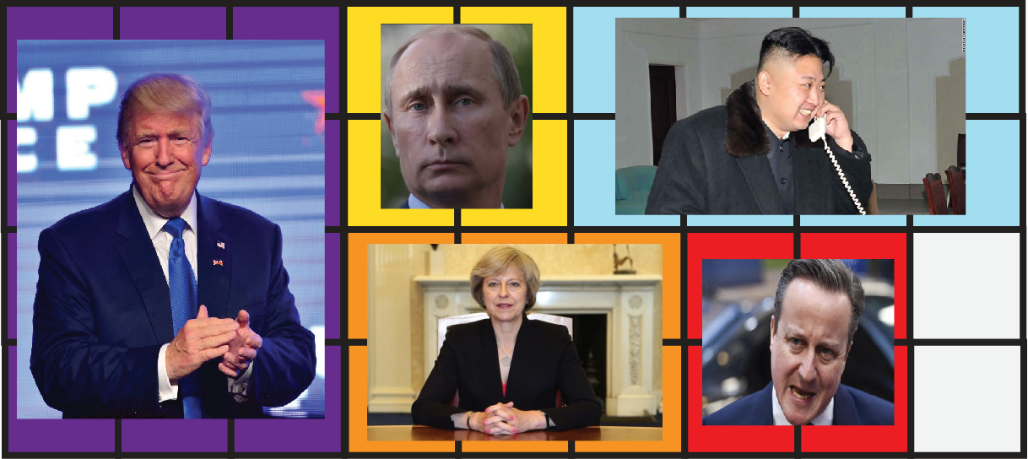
Classification Boosting with z Majority Voting

Slide 17
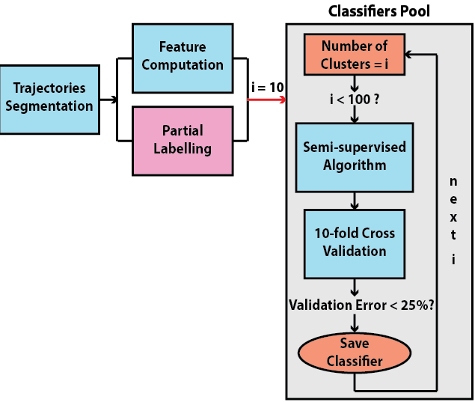
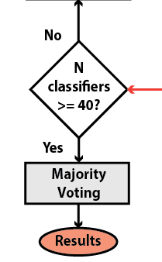
Updated Methodology

Slide 18
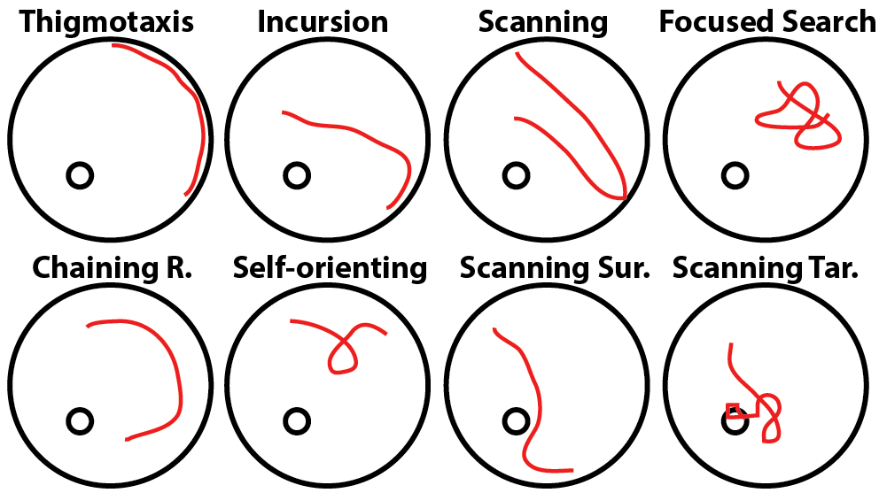
Classes of Behaviour

Slide 19
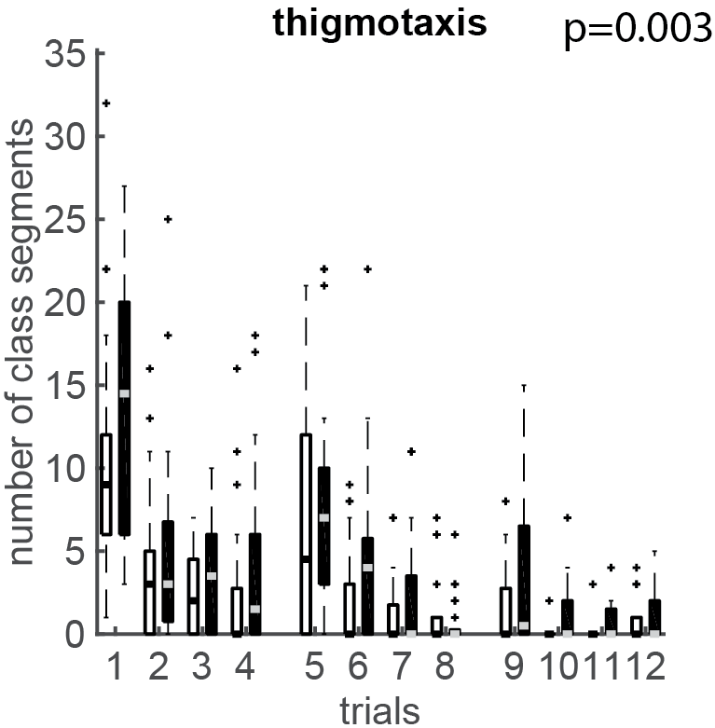
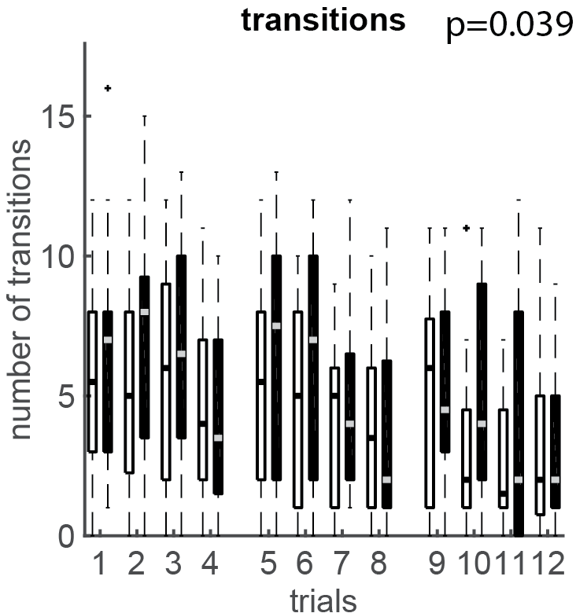
Results (ensemble)
Notes:
Friedman test:
Used for the analysis of variance of each strategy between the two animal groups.
(Non-parametric) because the data are not normally distributed. Ability to control the variability among subjects over different observations (each animal performed 12 trials).
Null hypothesis: there is no difference between the two animal groups over each one of the strategies (p is set to 0.05).

Slide 20
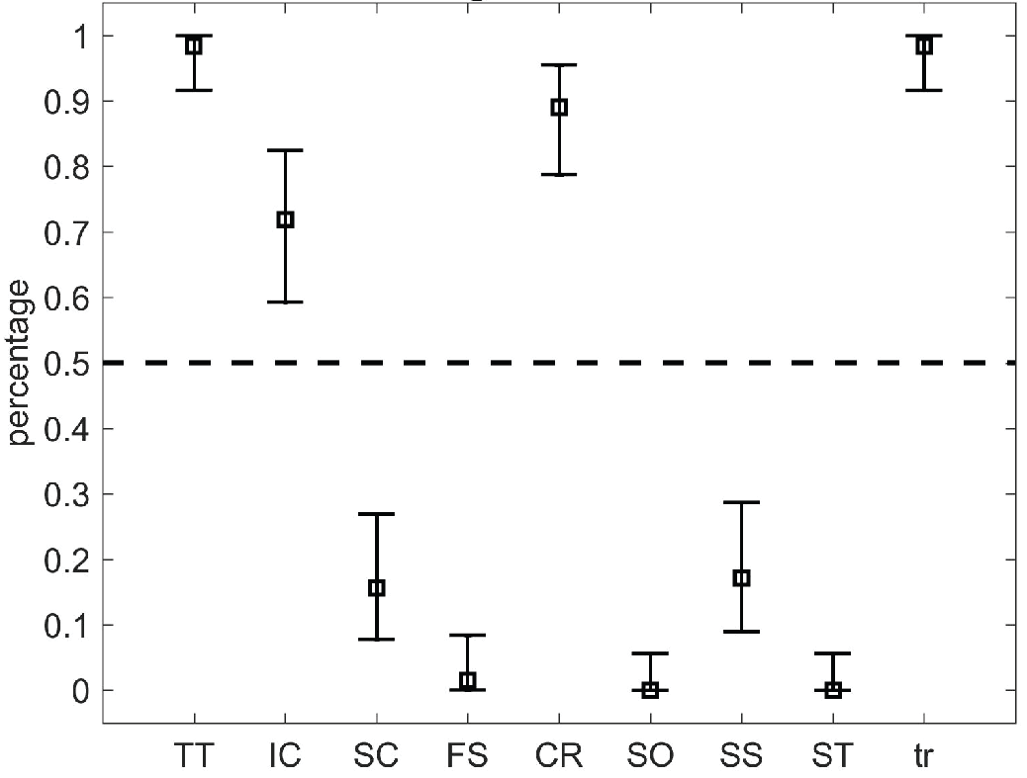
Results (classifiers)

Slide 21
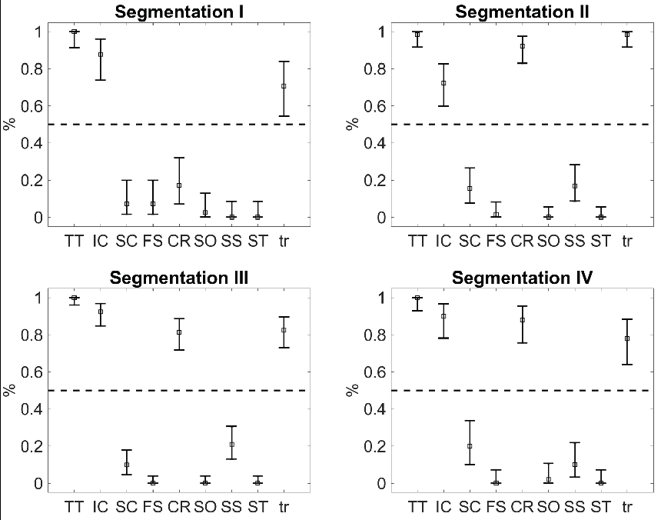
3*R
2*R
Notes:
Validation for 4 different segmentation configurations

Slide 22
Results (ensemble)

Slide 23
Comparison with other methods

Slide 24
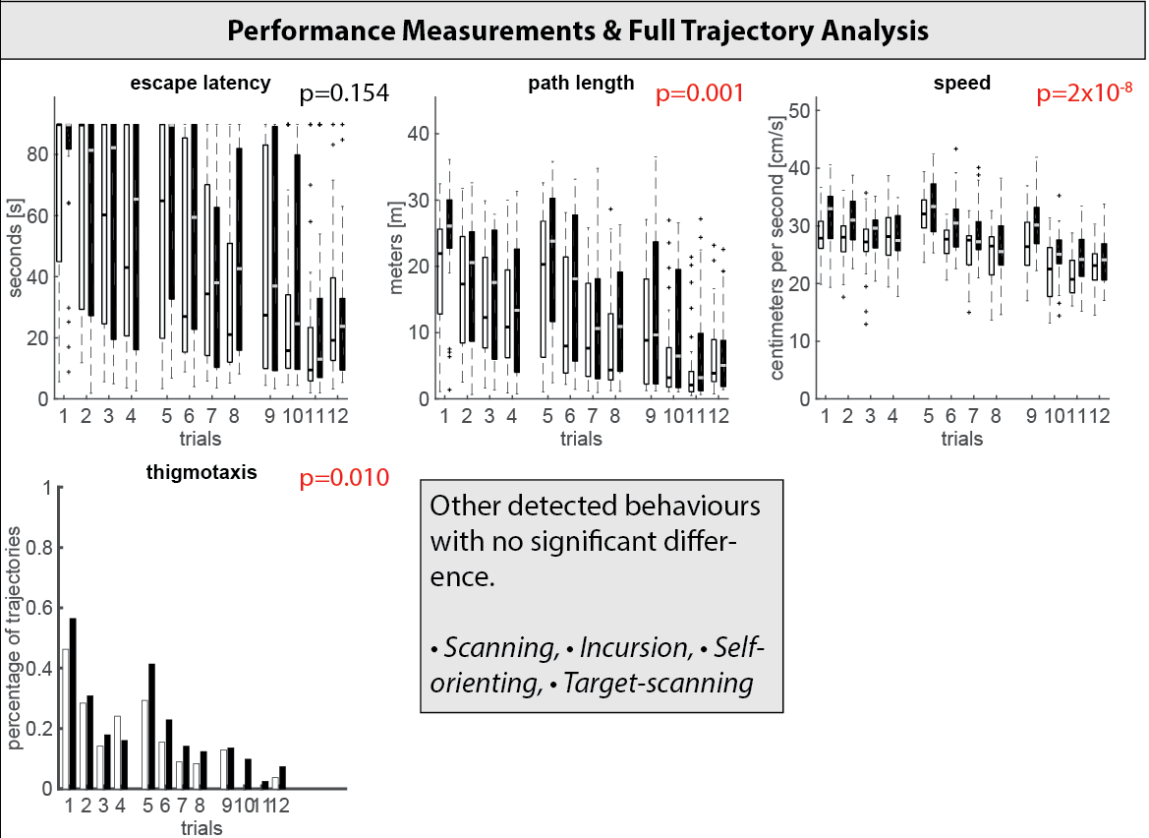

Slide 25
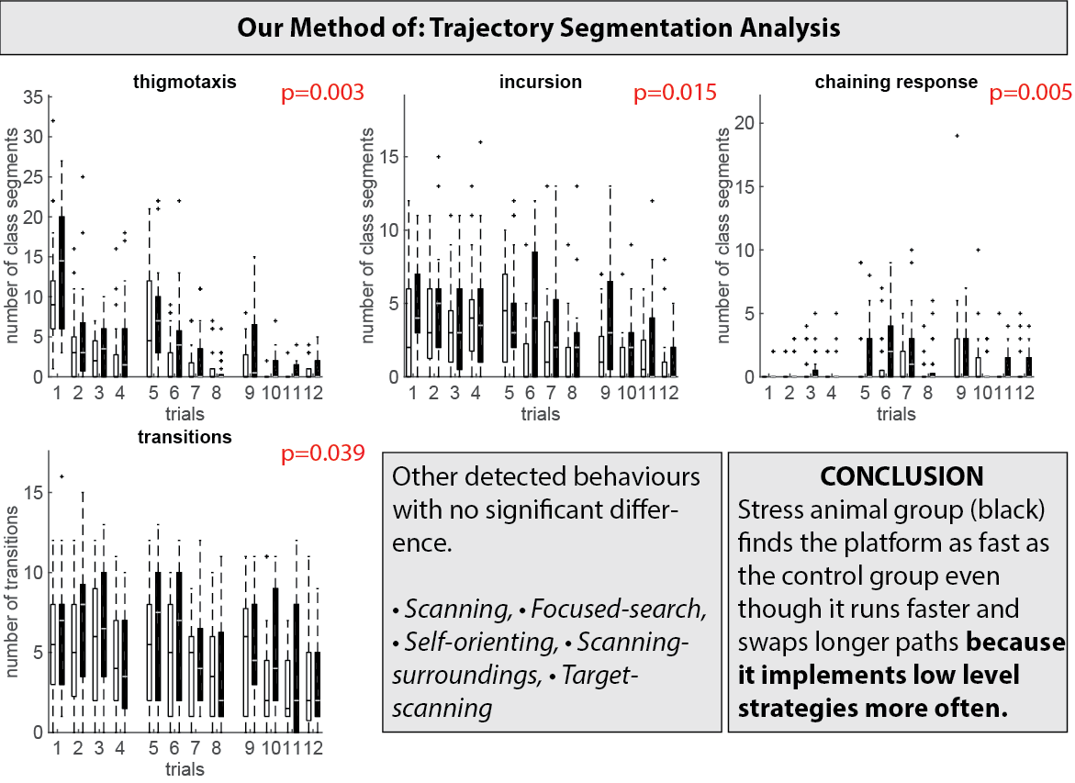
Notes:
CR: not low level but still on average the animal needs more time to approach the location of the platform.

Slide 26
Future Work
Supervised
Learning
Unsupervised
Learning
Semi-supervised
Learning

Slide 27
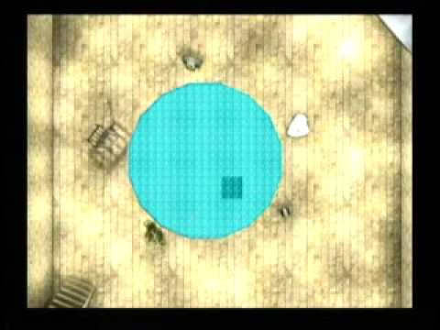
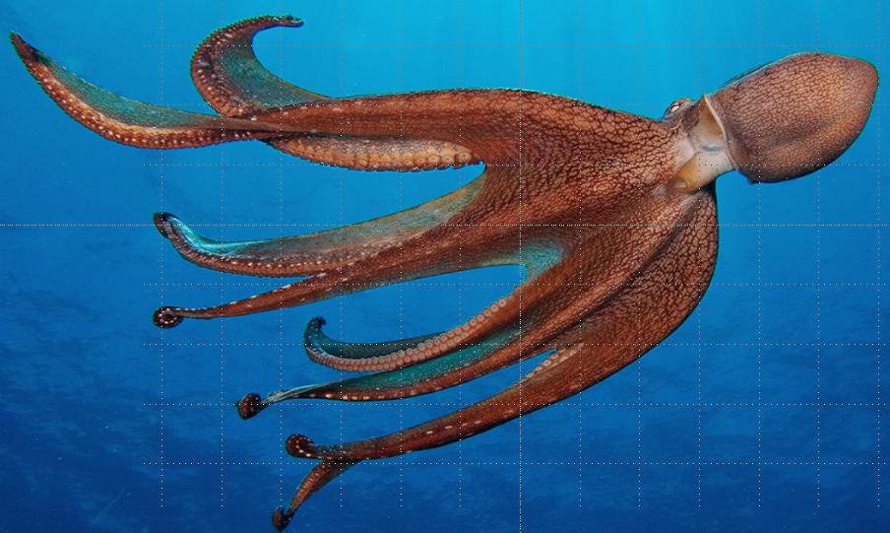
Future Work
Gehring, T. V., Wesierska, M. J., Wójcik, D. K., & Vasilaki, E. (2017). Analysis of behaviour in the Active Allothetic Place Avoidance task based on cluster analysis of the rat movement motifs. bioRxiv, 157859.

Slide 28
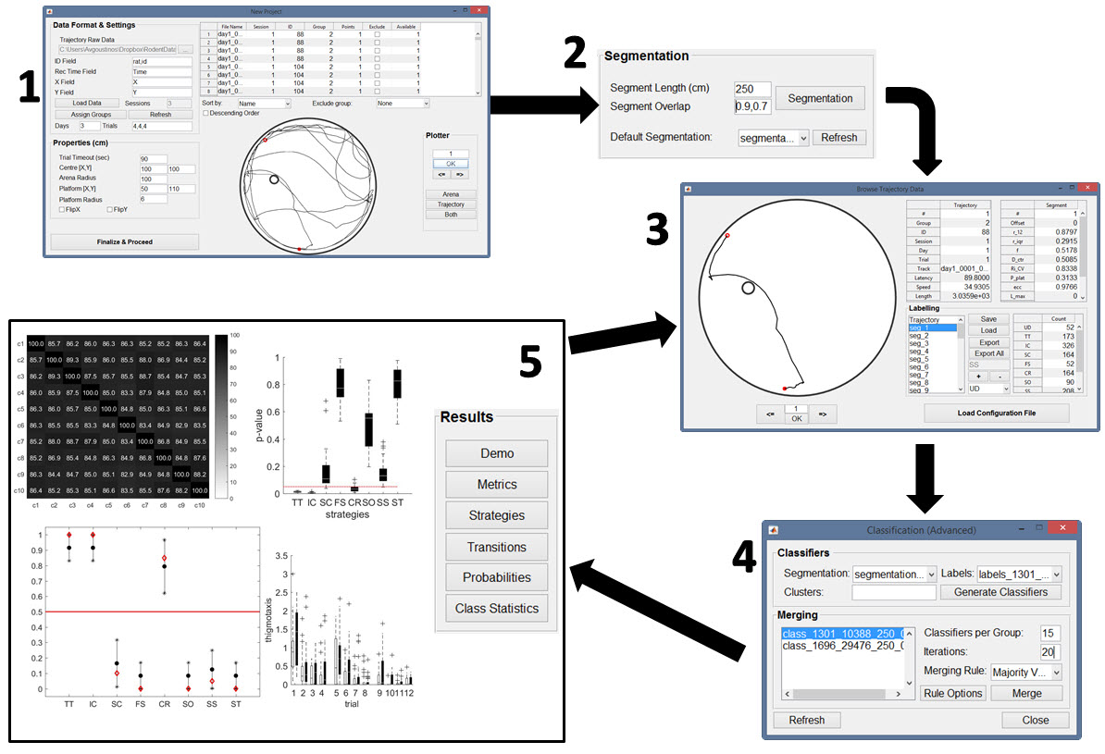
Software Demo
Notes:
Need to have:
- Tiago’s data already loaded in the new project window.
After new project window close and go to load project.
New software version (the one I demonstrate) out by the end of July!

Slide 29
Acknowledgements
Eleni Vasilaki (Project Leader)
Mike Croucher (Senior Research Software Engineer)
Tiago V. Gehring (PhD)
Special thanks to
Carmen Sandi & Gediminas Luksys (EPFL)
Nencki:
Kinga Szydłowska & Katarzyna Lukasiuk
Artur Janusz & Witold Konopka
Daniel Wójcik

Slide 30
Citations
Gehring, T. V., Luksys, G., Sandi, C., & Vasilaki, E. (2015). Detailed classification of swimming paths in the Morris Water Maze: multiple strategies within one trial. Scientific reports, 5.
Gehring, T. V., Wesierska, M. J., Wójcik, D. K., & Vasilaki, E. (2017). Analysis of behaviour in the Active Allothetic Place Avoidance task based on cluster analysis of the rat movement motifs. bioRxiv, 157859.
Vouros et al. Manuscript under preparation.
Github Repo:
https://github.com/RodentDataAnalytics/mwm-ml-gen/releases

